Slide 1

Smart Home IoT Applications
Making Life Easier with Innovative Technology
Presented by ANKITA SAHU

Slide 2

What is IoT?
1
Connected Devices
2
Data Sharing
Internet of Things (IoT) links everyday gadgets to the web.
Allows devices to communicate and exchange information.

Slide 3
Benefits of Smart Homes
Convenience
Energy Efficiency
Security
Control appliances and settings from anywhere.
Save on utilities with smart thermostats.
Monitor your home with smart cameras and alarms.

Slide 4
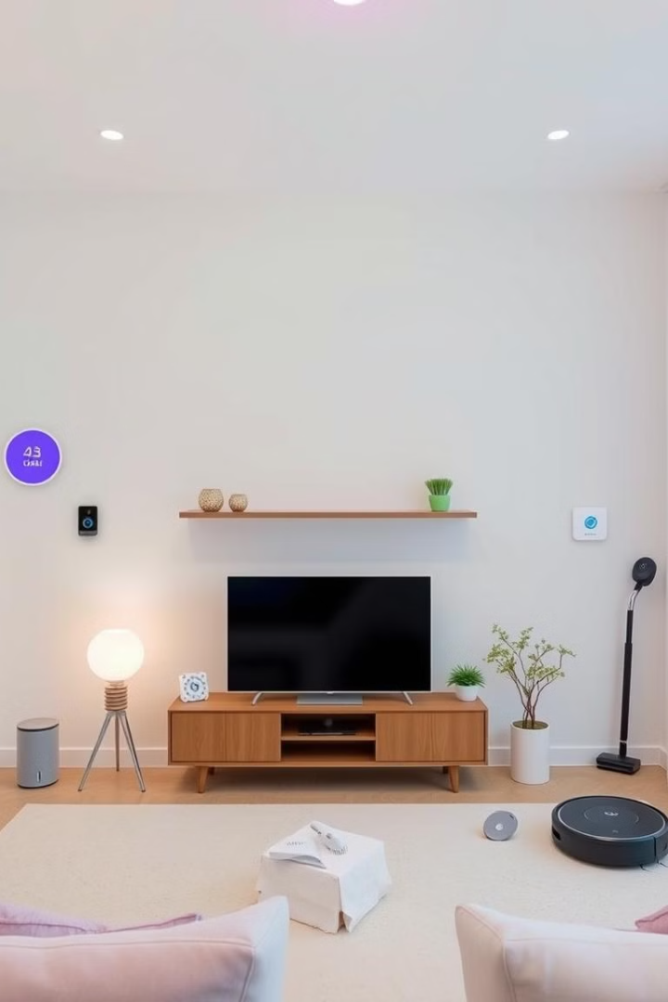




Common Smart Home Devices
Smart Speakers
Amazon Echo, Google Home
Smart Lights
Control brightness and colors
Smart Thermostats
Adjust temperature automatically
Smart Security Cameras
Monitor your home in real-time

Slide 5
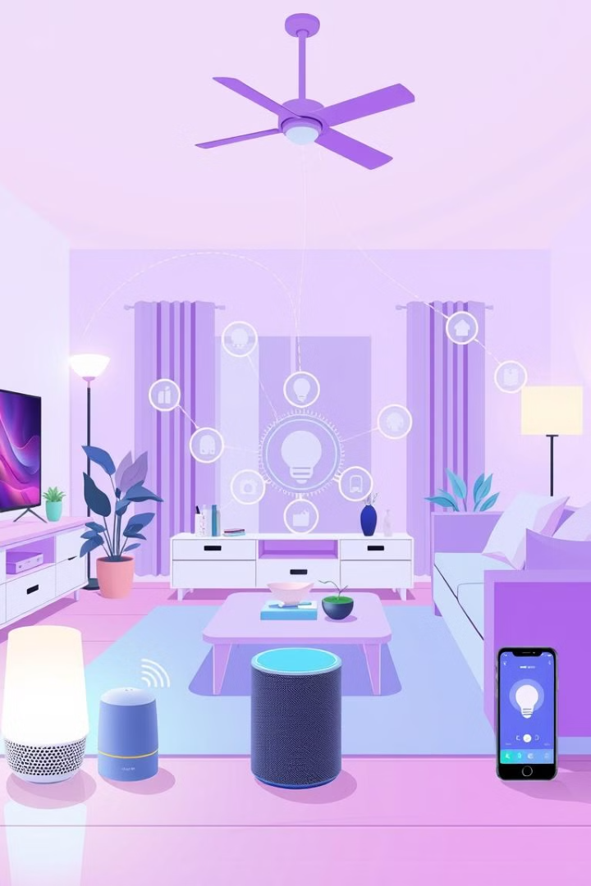
How Smart Home IoT Works
1
Devices
Sensors, cameras, and other connected gadgets
2
Hub
Central control unit to coordinate devices
3
App
User interface to manage and monitor everything

Slide 6

Thank You
Discover the Power of Smart Home Technology

